Slide 1
SN Bank
Executive Summary Report for Predicting Customer Churn Rate Analysis Report
By Mariam Ariya
31st August 2022

Slide 2
Business Understanding
One of the main goals of a business is to acquire and retain its customers to grow the company. Every time a customer leaves, there's a significant loss in the time and resources invested.
The ability to predict which customer is likely to churn is therefore important as it informs the decision of the right marketing approach to offer to the customers to make them stay which in turn makes a positive increase in revenue.

Slide 3
Goal
SN Bank is a financial institution that caters to the financial needs of its customers. They are interested in identifying customers that are at the risk of cancelling which would inform their decision of what marketing action to adopt for everyone to maximize the chances that they will stay.
The business goal is to build a predictive model to forecast the likelihood of their customers churning out from their services.

Slide 4
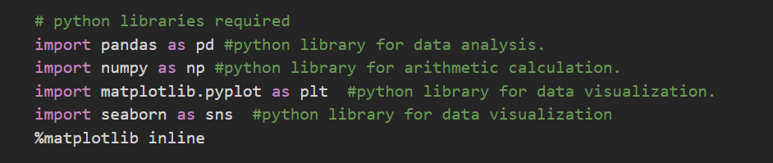
Data Understanding
The dataset was opened in Microsoft Excel, saved in a csv format and imported into Jupyter Notebook which is the IDE used for this project.
Started by importing all necessary modules for the analysis.
A dataframe called df was created and data loaded into it using the pd.read_csv() method since the data was saved in a csv format.
After loading, the data was validated by using the df.head() and df.tail() methods to get the first 5 and last 5 rows respectively.

Slide 5
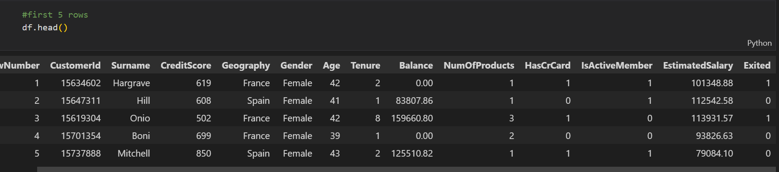
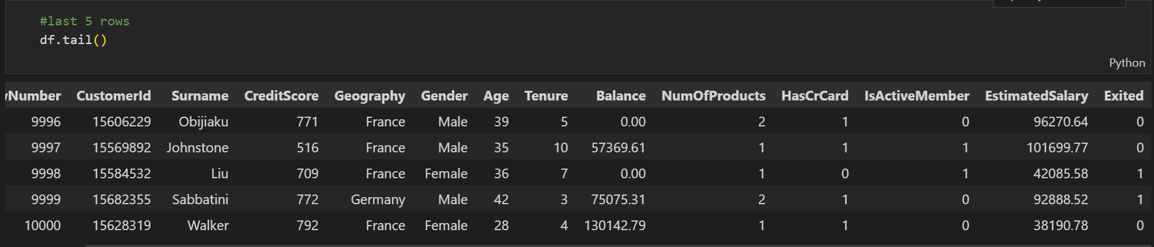

Slide 6
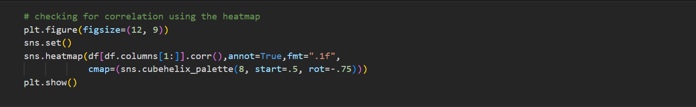
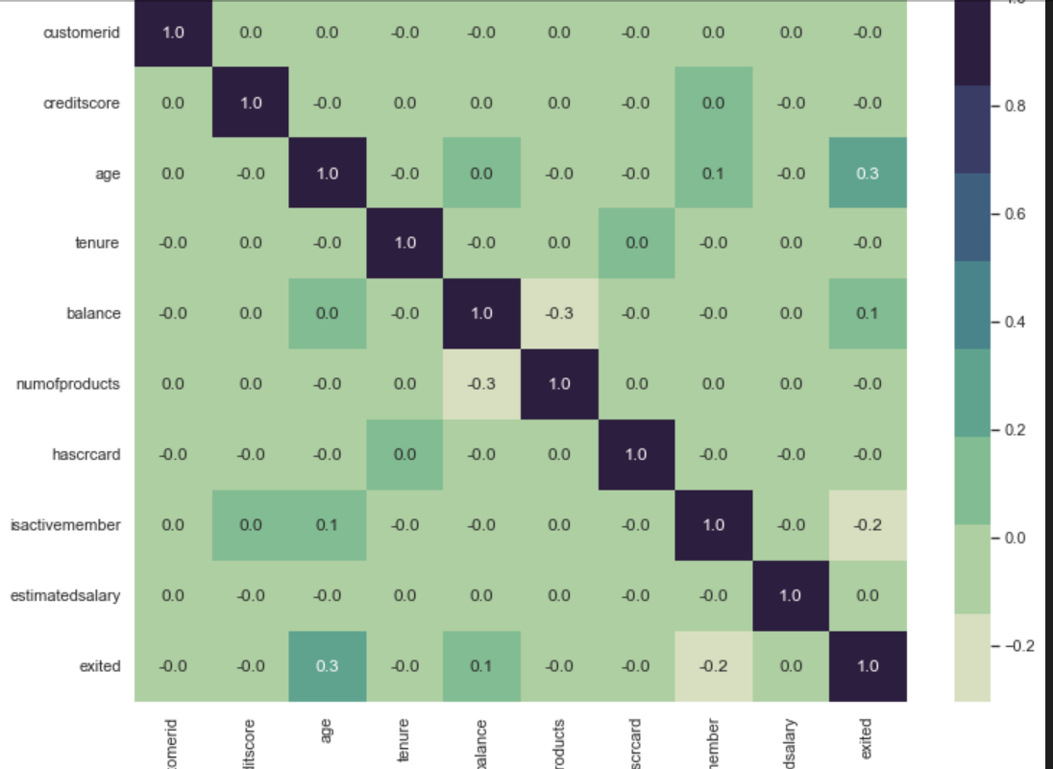
Performed correlational analysis using the heatmap to show relationship between variables of the dataset.

Slide 7
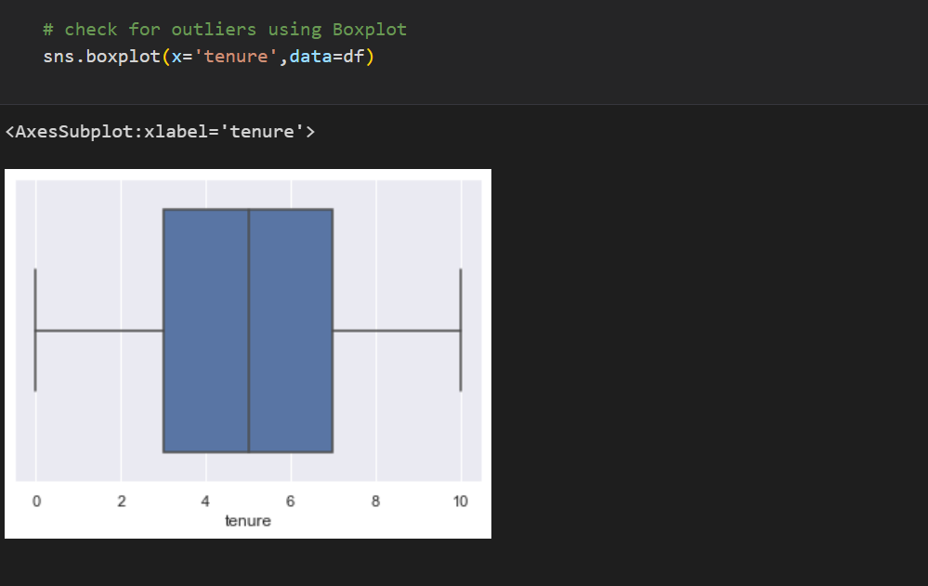
From the heatmap above, it is seen that there is absolutely no relationship between a customers age and his tenure and age and credit score.
Performed an outlier analysis to check for extreme tenure values using a boxplot visual.
There are no outliers in tenure column.

Slide 8
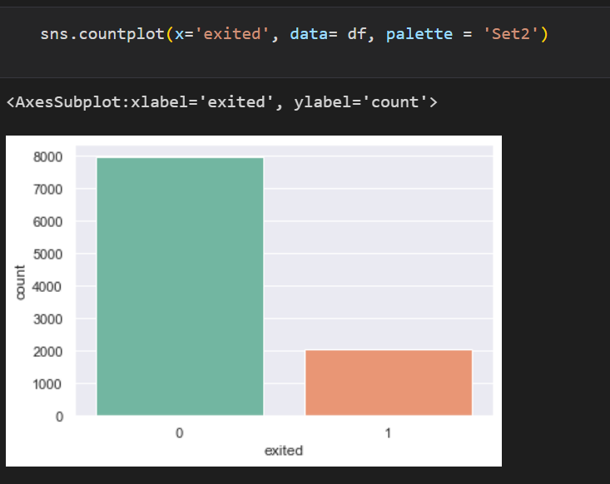
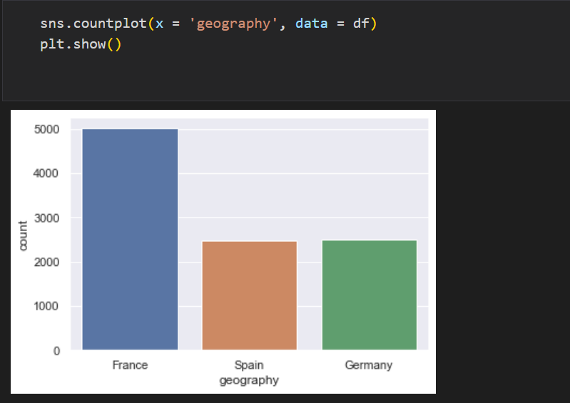
Of a total of 10,000 customers of SN Bank, approximately 2000 have exited .
About 50% of the SN customers are from France while the rest are almost equally distributed between Germany and Spain.

Slide 9
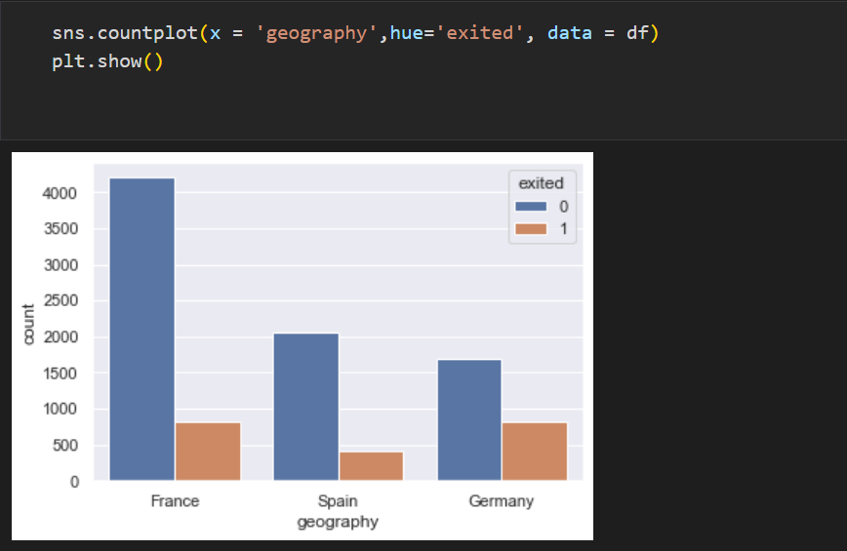
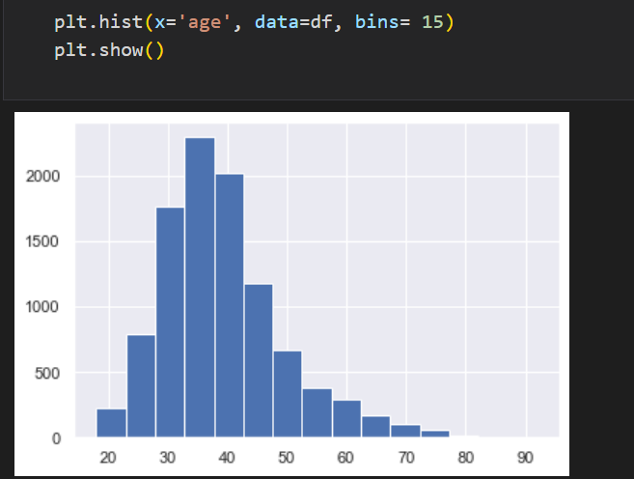
From the visual above,
churned customers are lesser in Spain than France and Germany.
Germany and Spain have about the same number of churned customer.
Age group 30-40 form a large part of the customer population.

Slide 10
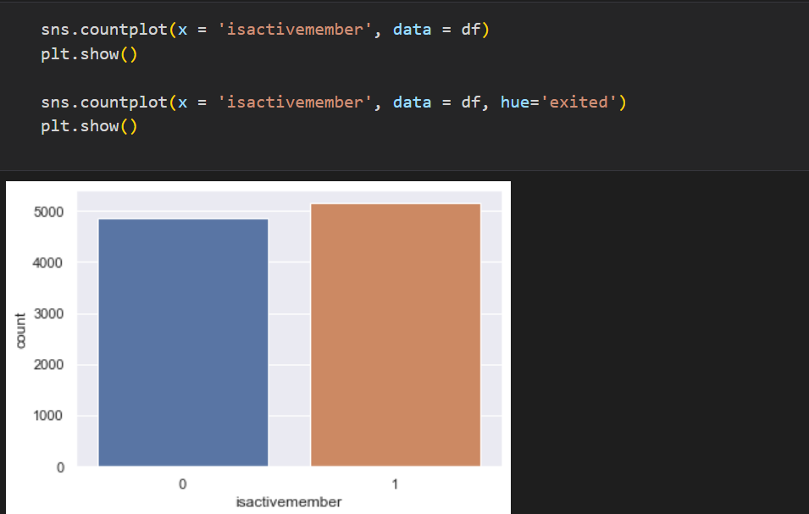
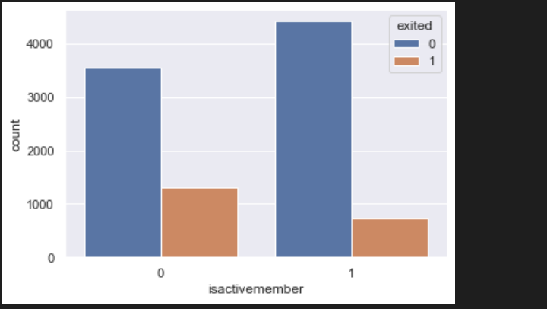
The percentage of active customers is slightly above 50%
More inactive members tend to churn than active members

Slide 11
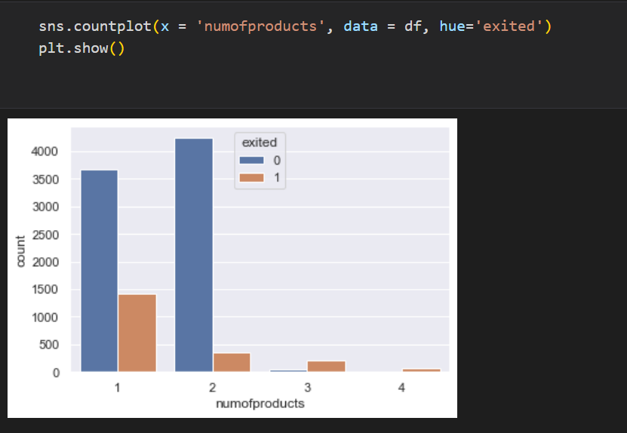
Customers who use just a product from SN Bank churned the most with almost 1500 exits while the churn rate for customers who use 2,3 or 4 products are less than 500 each.
The high churn rate with product 1 maybe due to frustration if the product encounters a fault. It is recommended that customers are cajoled into signing up for more SN Bank products.

Slide 12
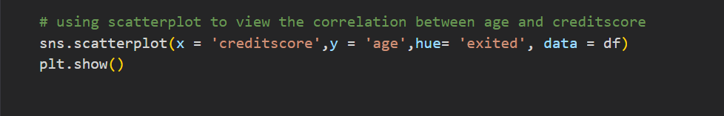
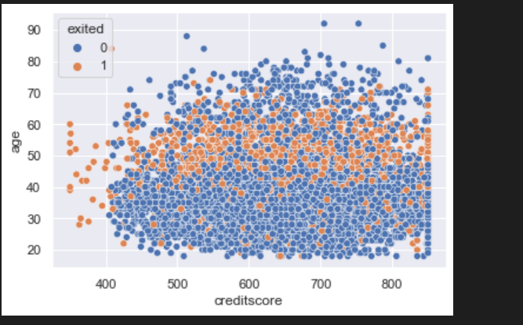
A weak positive correlation was noticed between customers age and their creditscore.
Customers within age 40 to 60 are more likely to churn irrespective of their creditscore than the rest of the customers.

Slide 13
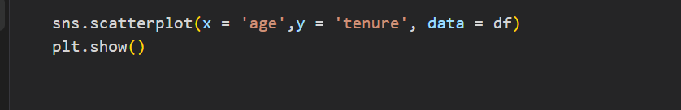
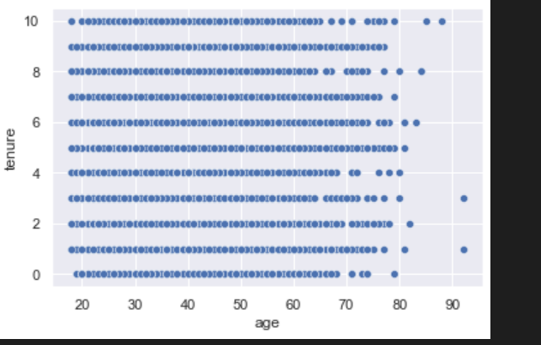
There is absolutely no correlation between the customers age and his tenure in SN Bank.

Slide 14
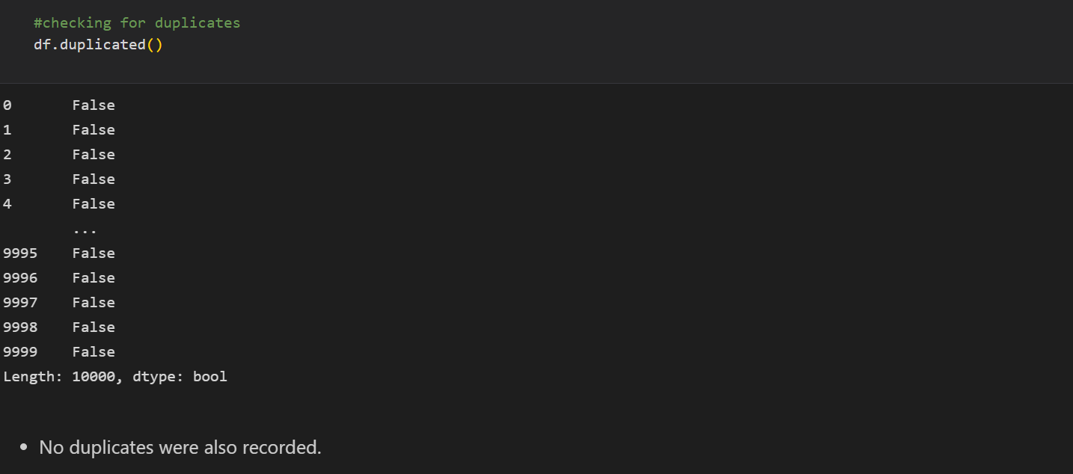
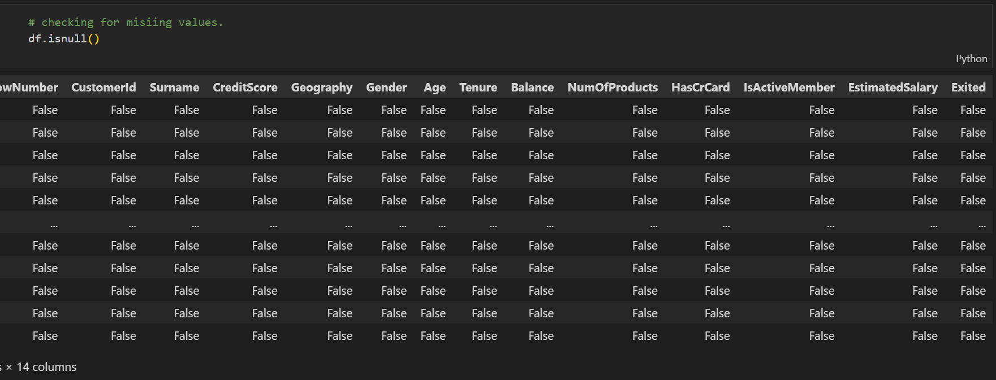
Data Cleaning
This process involved checking for missing and duplicates values, converting column names to lower cases, performing correlational and outlier analysis to check the relationship between variables and extreme values, respectively and feature engineering.
Used .isnull() method to check for missing values and .duplicated() to check for duplicate data.
If missing or duplicate data are found, it is important to treat before proceeding with the analysis.

Slide 15
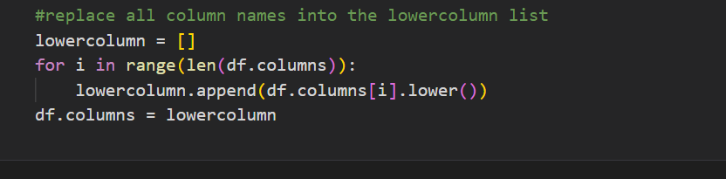
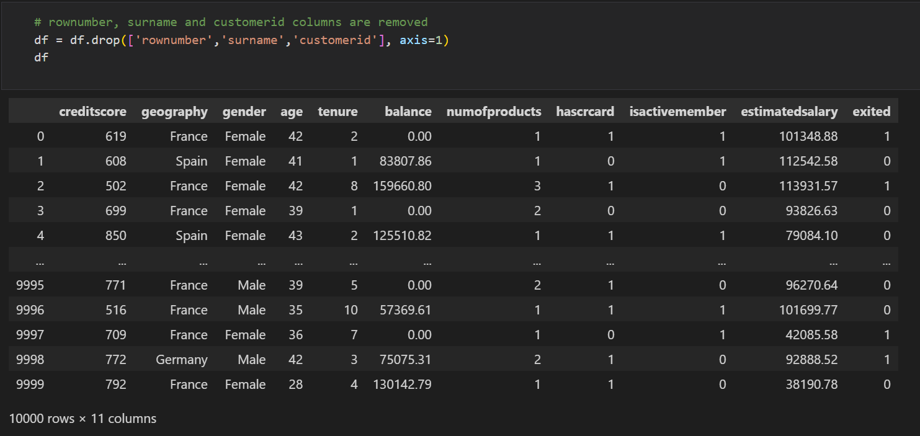
Cleaned the columns by converting to lower cases using .lower() method.
Featured Engineering
This process involves creating new metrics for columns needed for the analysis, removing variables not needed and changing categorical variables to numeric to prepare for model building.
Rownumber, surname and customerid columns were dropped by using .drop() method and df was loaded to validate the drop.

Slide 16
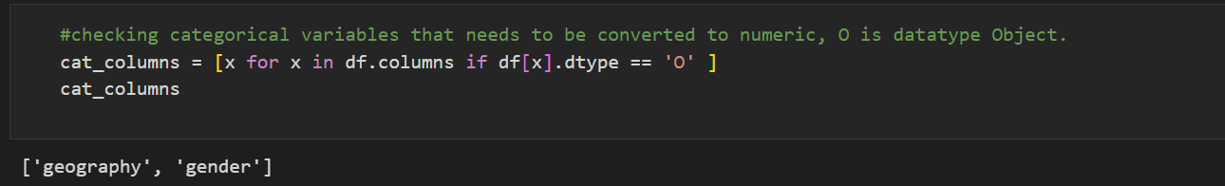
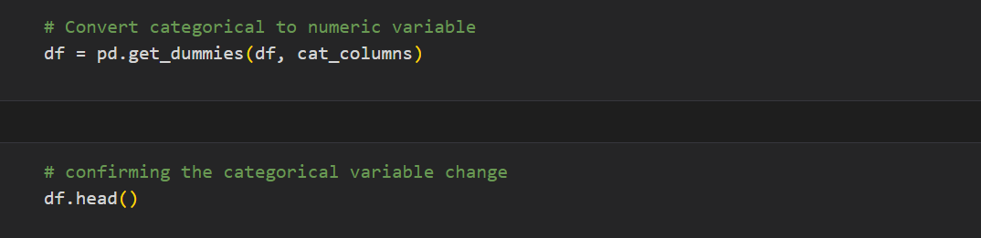
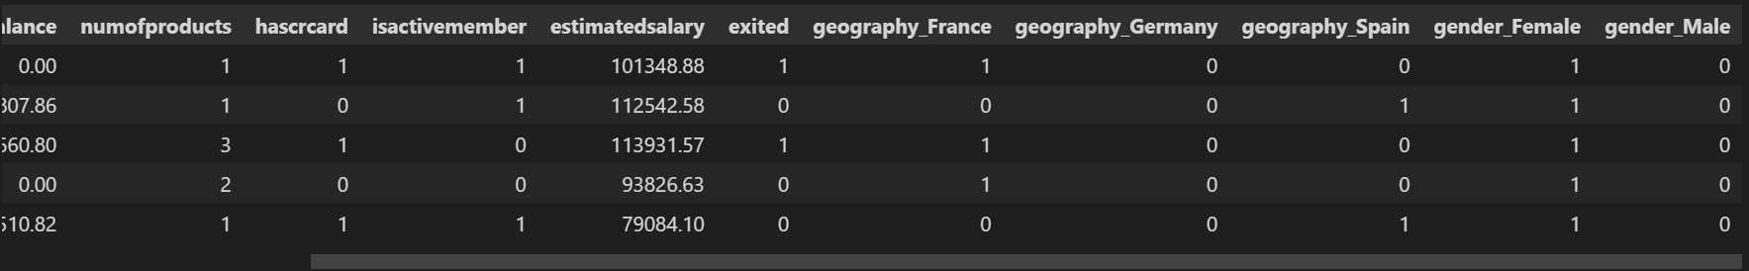
Checked for categorical columns that are in the dataset because they have to be converted to numeric.
The categorical variables found are geography(Spain, France and Germany) and gender(Male and Female).
Converting geography and gender columns to numeric(0 and 1) by using the .get_dummies() method and confirmed by running df.head() to show the categorical variable change.

Slide 17
Insights
There are a total of 10,000 observations in this dataset with 14 variables(columns)
There are no missing values, and all variables have their correct data types.
No duplicates were also recorded.
There are no outliers.
There is absolutely no correlation between the customers age and his tenure in SN Bank
Of a total of 10,000 customers, approximately 2000 customers have exited.
A weak positive correlation was noticed between customers age and their creditscore.
Customers within age 40 to 60 are more likely to churn irrespective of their creditscore than the rest of the customers.
About 50% of the SN customers are from France while the rest are almost equally distributed between Germany and Spain.
Age group 30-40 form a large part of the customer population.
The percentage of active customers is slightly above 50%.
Customers who use just a product from SN Bank churned the most with almost 1500 exits while the churn rate for customers who use 2,3 or 4 products are less than 500 each.

Slide 18
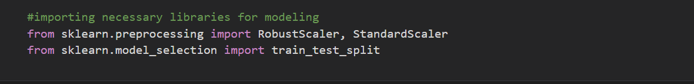
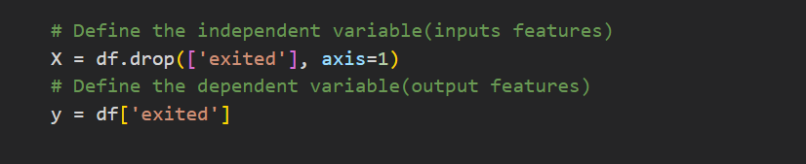
Modelling
This prediction model is a classification model since the result will either be a True/False or Yes /No and the model will be built with XGBoost Classifier Algorithm.
We also must define the input(independent variables) and output(dependent variables) features. The dependent variable will be the column to be predicted while the independent will be all other columns after the forecasted column has been dropped. The dependent variable will be dropped using the .drop() method in python.
The necessary python libraries needed for machine learning are also imported below:

Slide 19
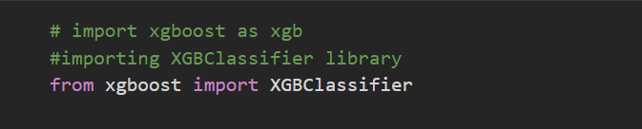
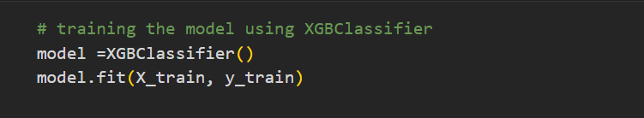
The data must be split into Training and Testing sets which is usually divided using the 80:20 ratio rule i.e., model will be trained with 80% od the data and tested with 20% of the data.
The model used for this classification prediction is XGBoost Classifier which is imported below
and trained using the fit() method.

Slide 20
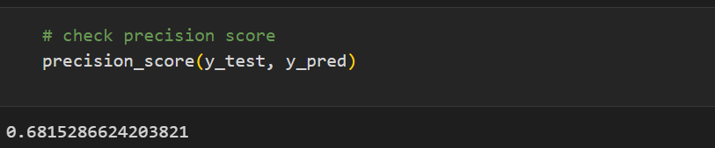
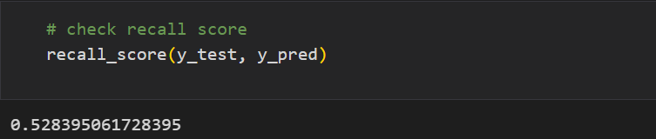
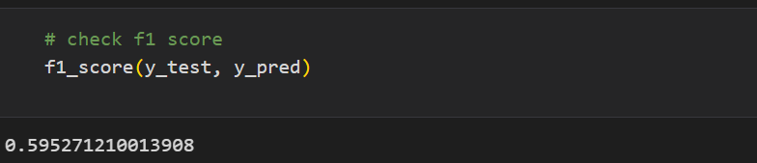
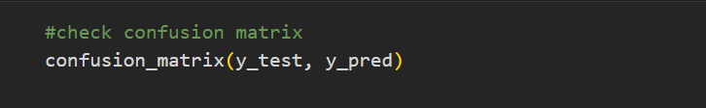
Model Evaluation
To evaluate the model, we have to import some metrics that are used to qualify the quality of the model such as precision_score, recall_score, f1_score and confusion_matrix for the sklearn.metrics package.
We proceed to check the precision score, recall score, f1 score and confusion matrix by running the codes below.

Slide 21
Insights
The model has:
Precision score of 68.15%
Recall value of 52.84%
f1_score of 59.53%.
Since these values aren't 100% but are more than 50%, this classifier can be said to be average.

